Slide 1

Internet of Things
Derek Badman
Pat Maynard
Linda George
Noor Pola

Slide 2
Introduction

Slide 3
What is IoT?!

Slide 4
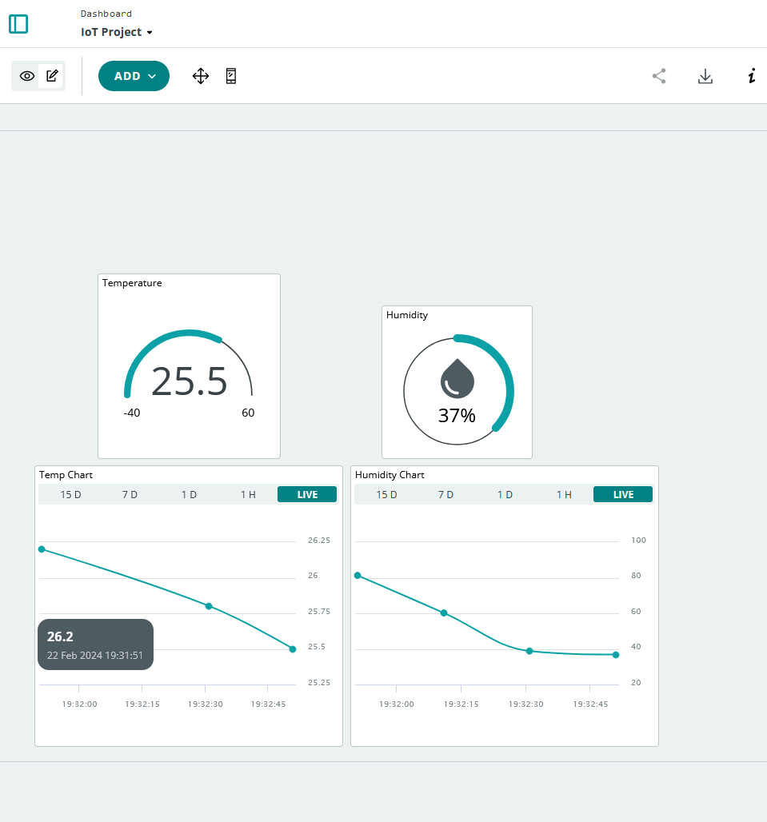
Our Experiment!
We set out to make a simple IoT cloud-based temperature and humidity monitoring system.

Slide 5
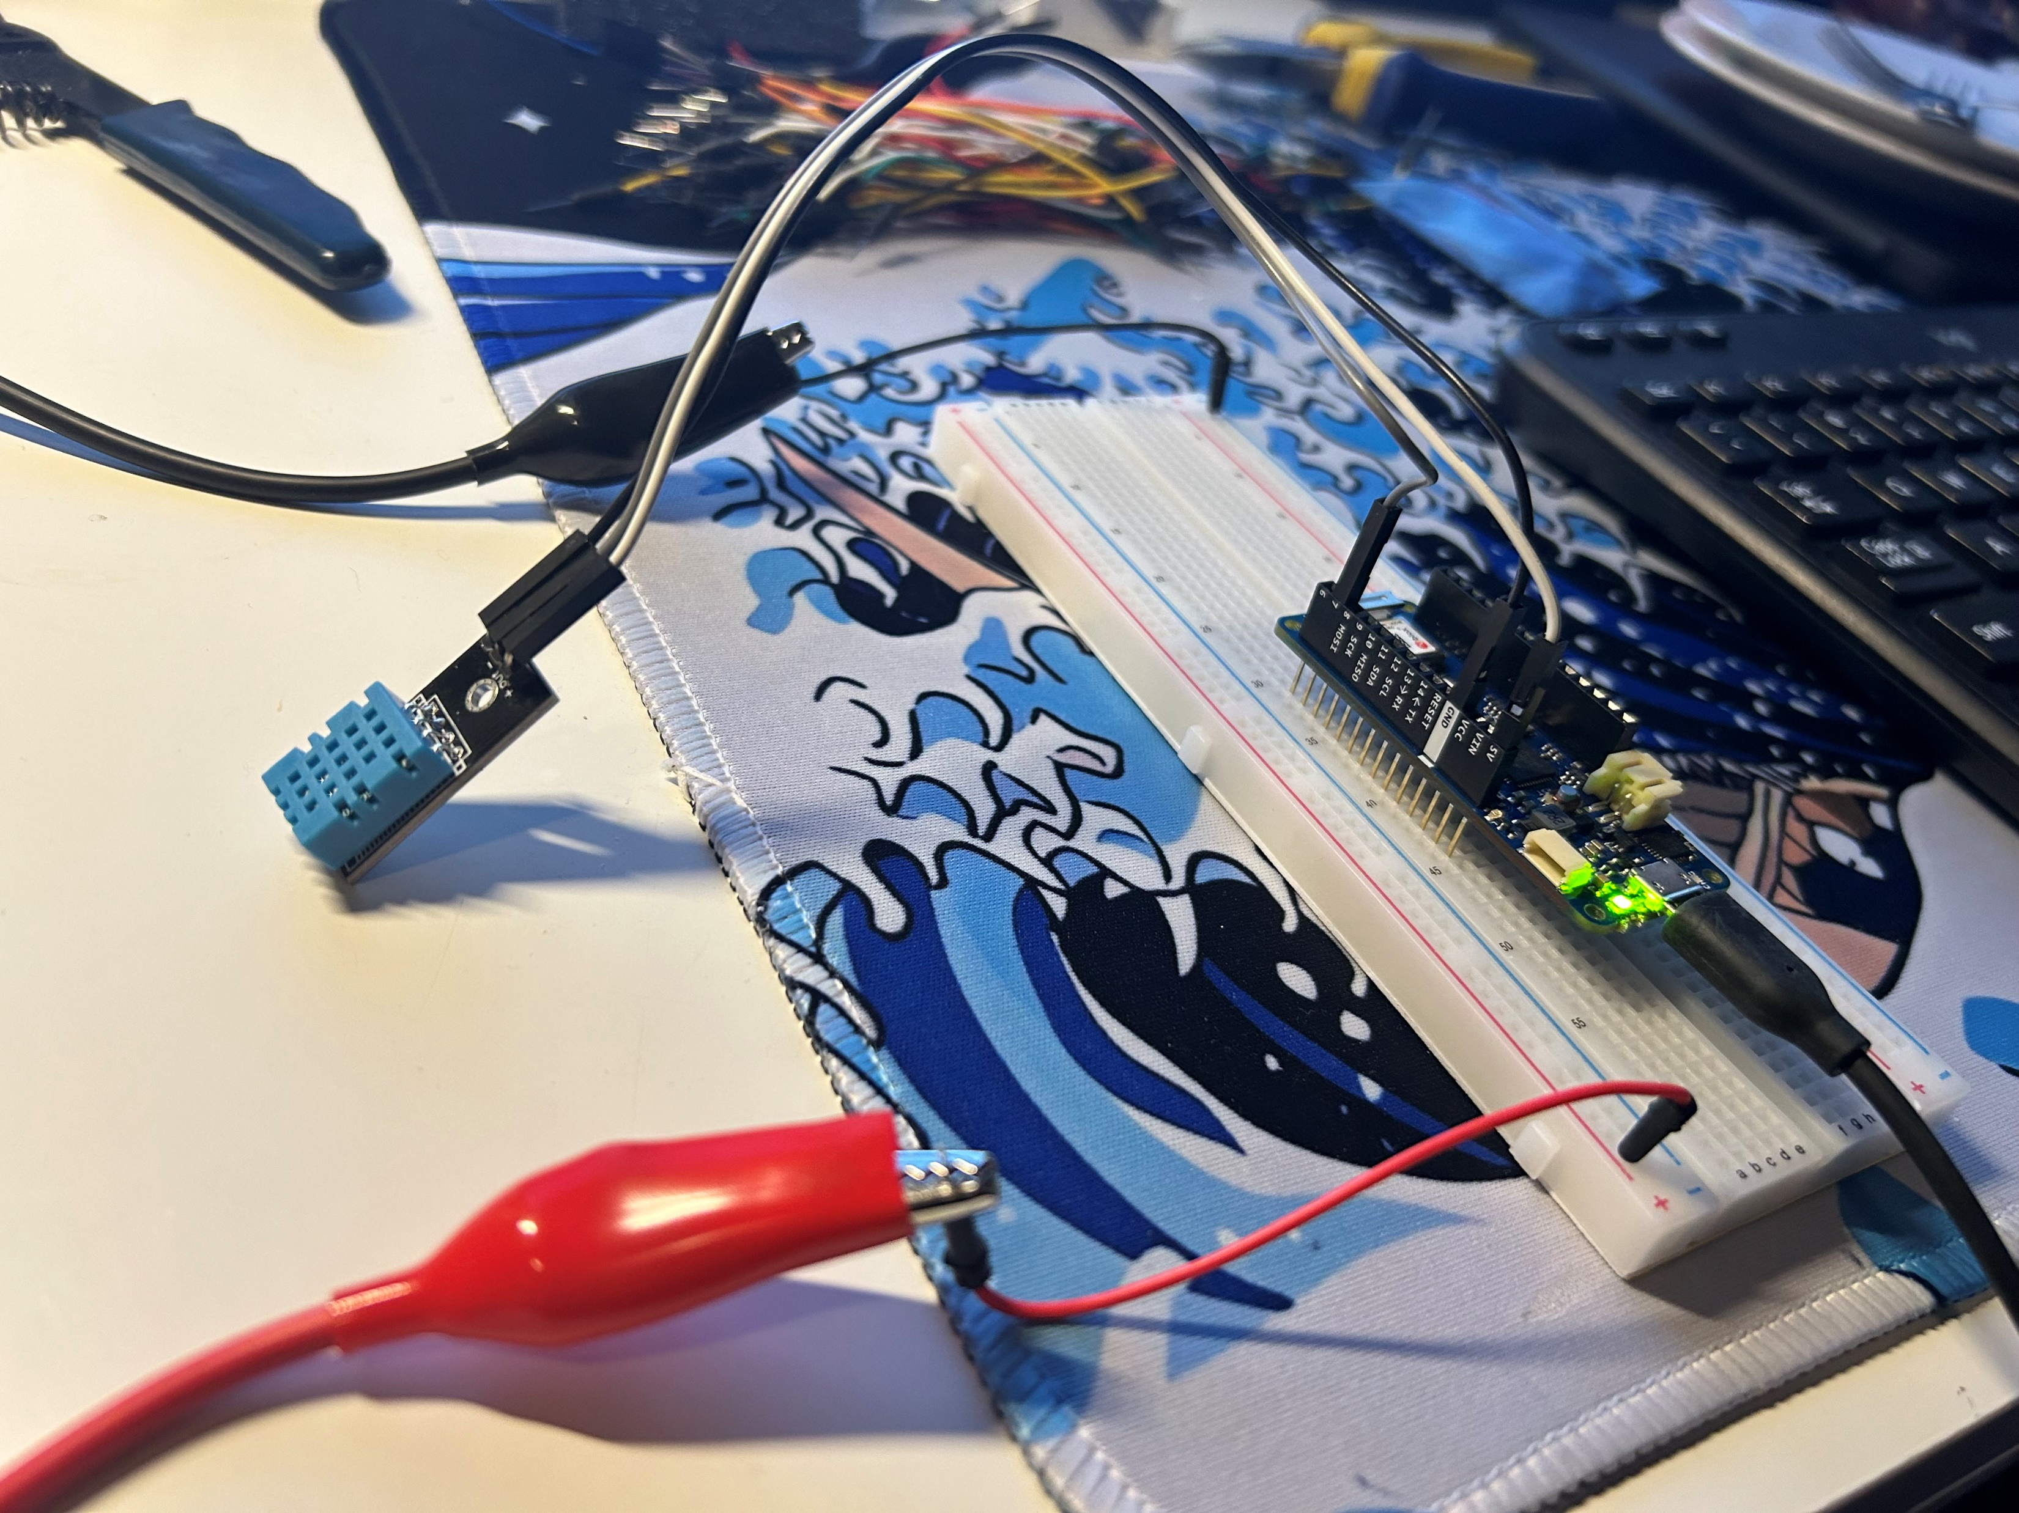
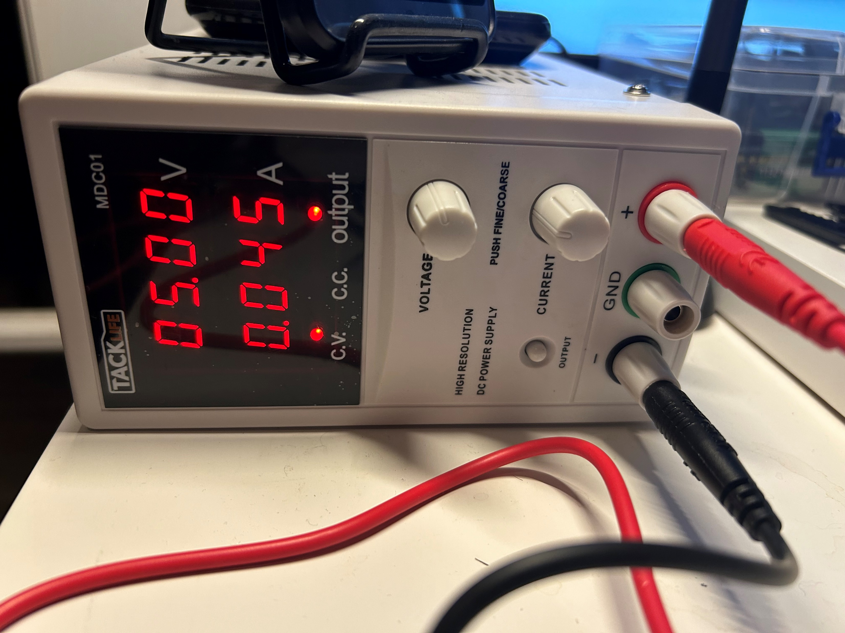
Physical Set-up
We connected an Arduino MKR 1010 wi-fi-enabled board to a DHT multi-function sensor and a power supply to send the signal to our cloud.

Slide 6
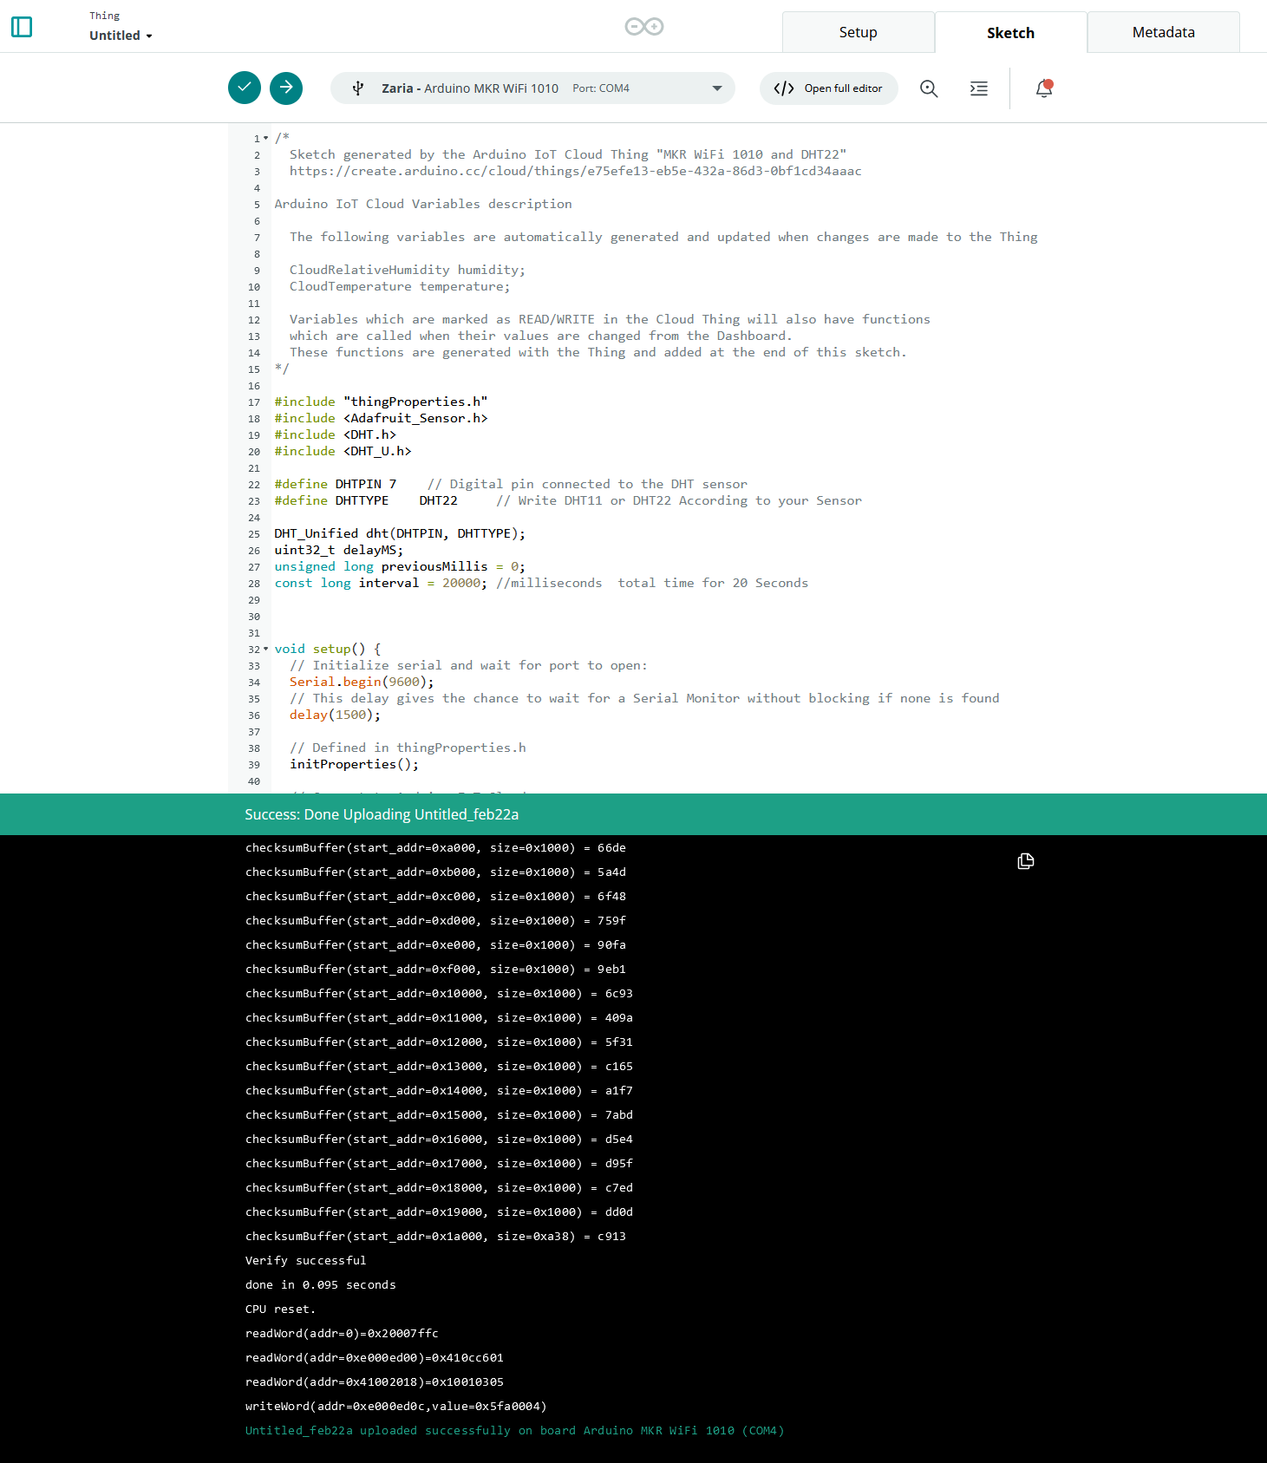
Code
Adding boilerplate code to the board for base functionality was the next step.
We used the browser-based IDE provided by Arduino Cloud.

Slide 7
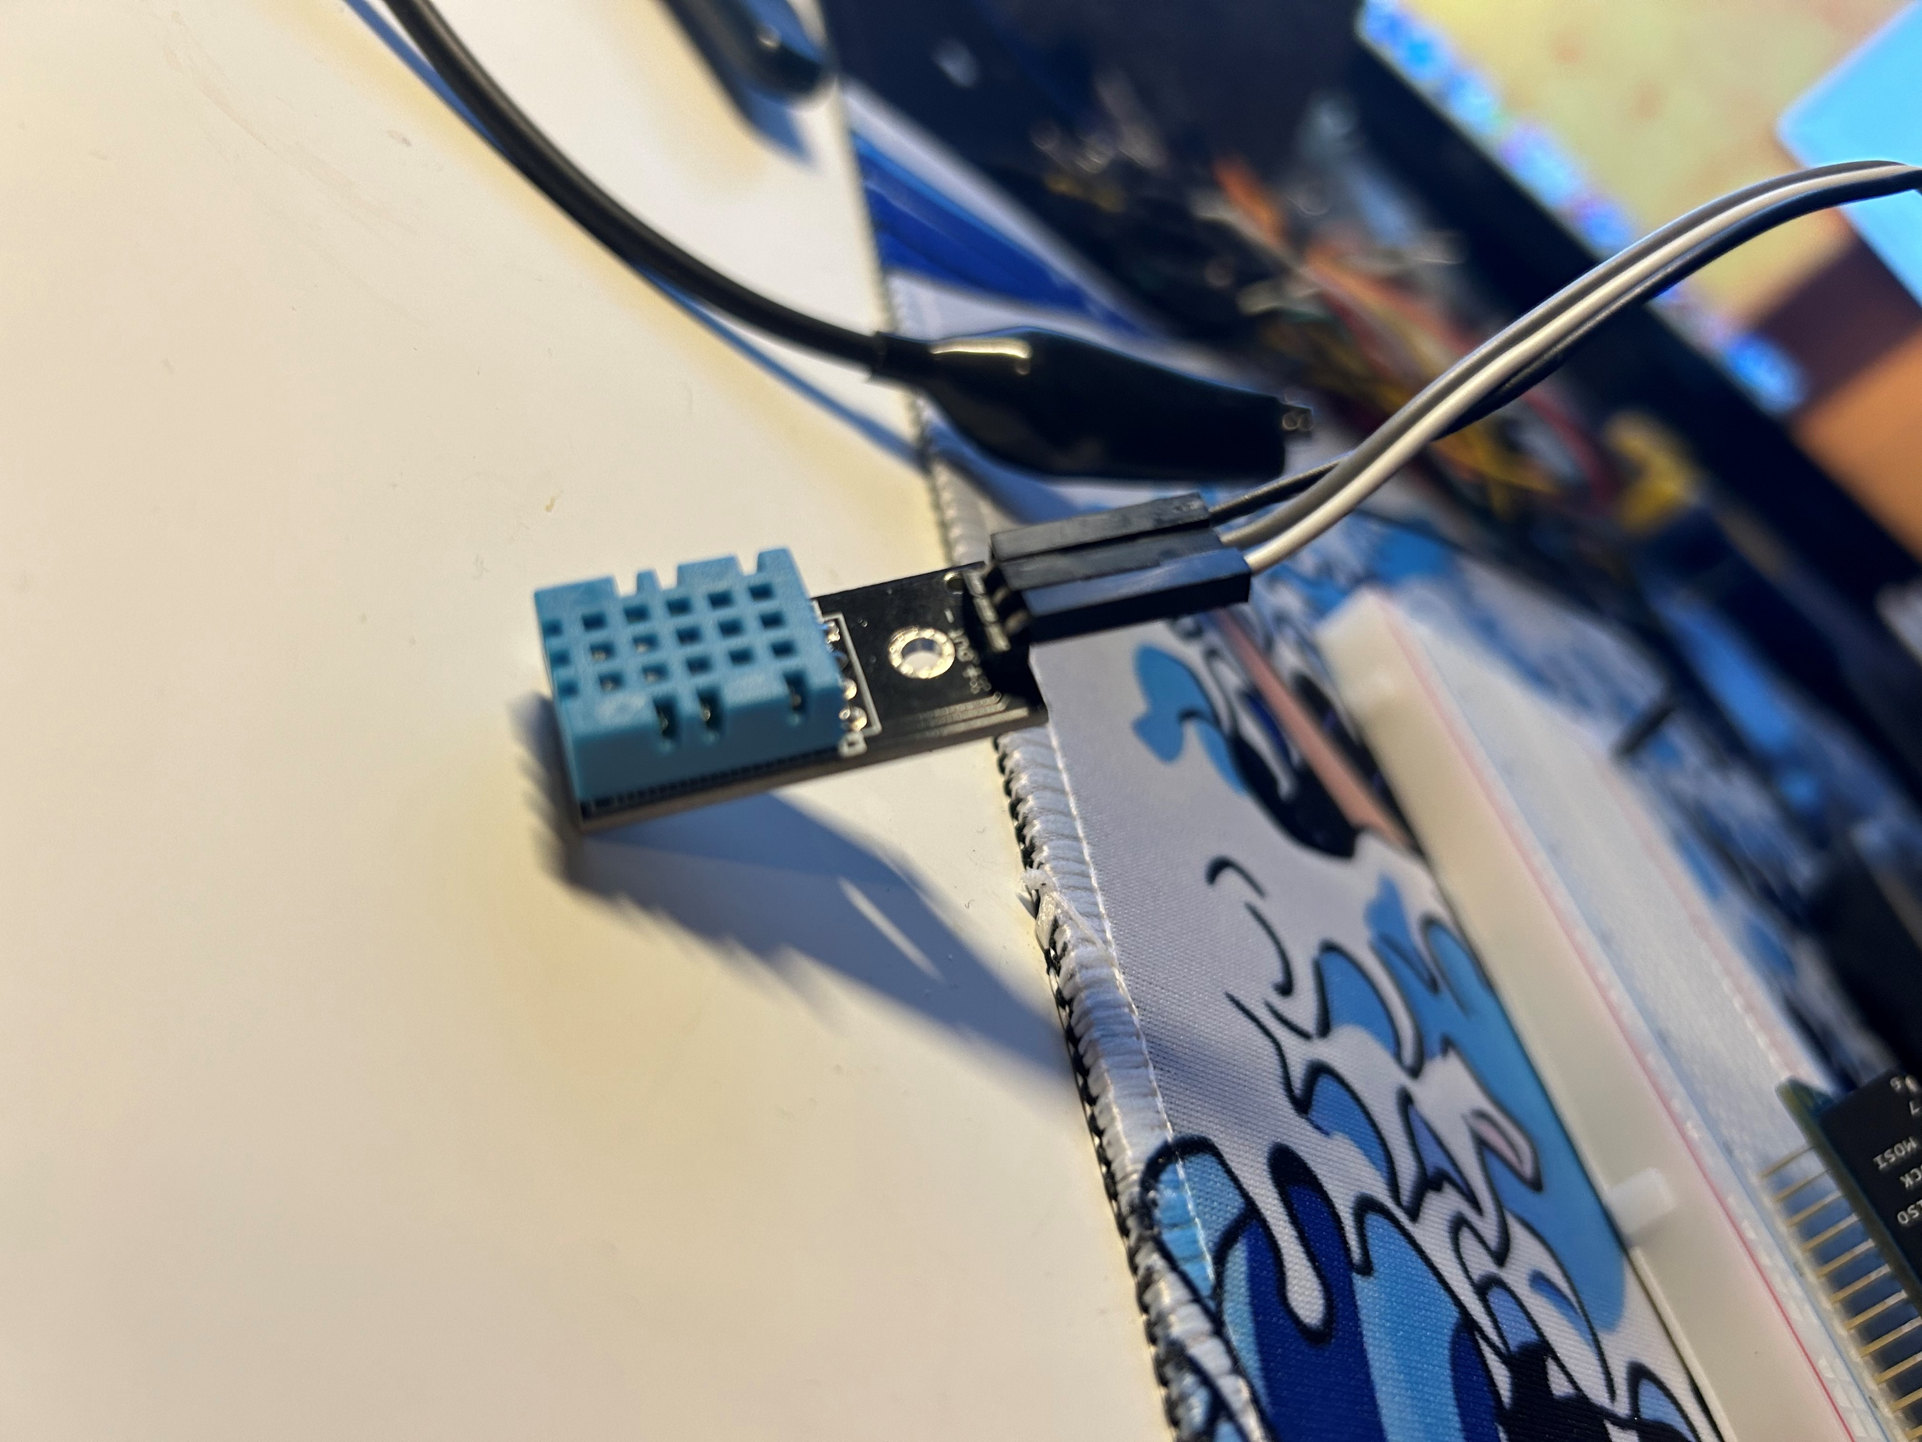
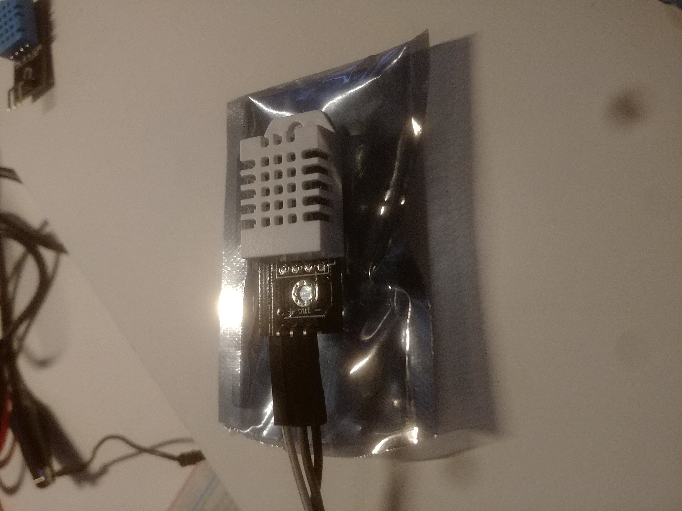
Troubleshooting
We had VERY high outputs initially. This raised a red flag that something was wrong with our setup.
After some analysis, replacing our sensor was necessary.
Switched from a DHT11 (Blue) to a DHT22 (White)

Slide 8
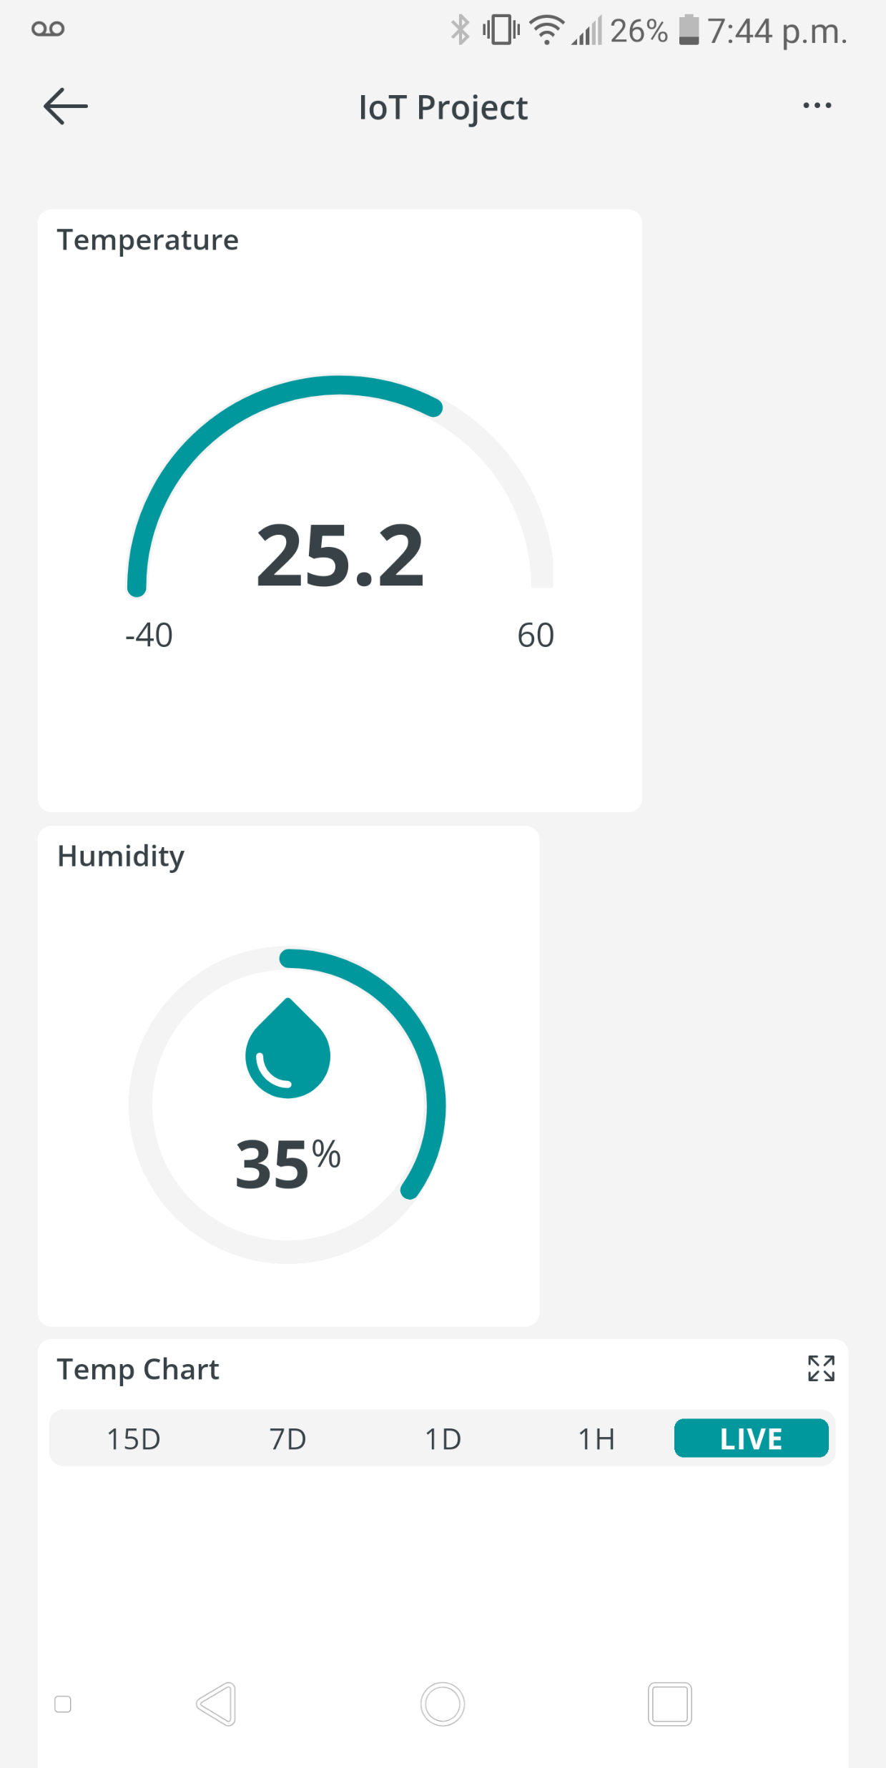
Dashboard
The final dashboard was a multi-platform output of our IoT sensor running on the cloud!

Slide 9
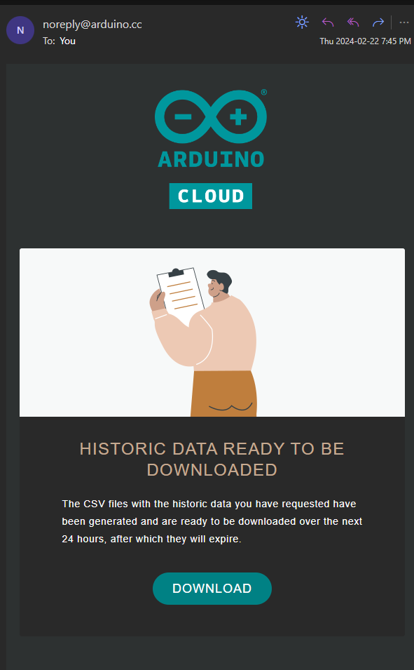
Data Export
After a few days of collecting data, we were able to export a CSV from the cloud to see what we have been gathering.

Slide 10
IoT in Industry

Slide 11
Security and Implementation

Slide 12

Next Steps for IoT
IoT is expected to undergo rapid growth to support increased user interface. To succeed in developing a technology that will continue to make societal impacts and leave a lasting footprint in technological history. IoT will need to focus on the following areas of development:

Slide 13

Next Steps for IoT Security & Regulations
As internet crime increasingly continues to rise (125% in 2021 compared to 2020), cybersecurity and the regulations are an important focus.
IoT developers are expected to incorporate cybersecurity measures such as encryption, certificate-based authentication, and security standardization across platforms.
Developers will be challenged by ensuring the technology and security measures conform to privacy legislation across global jurisdictions.

Slide 14

Next Steps for IoT Trends in Technology
As society evolves, technology is expected to become ever more integrated into the consumer’s daily life.
Internet of Things is expected to expand to a futuristic society that incorporates technology such as smart cities, wearables, and transportation.
Developers are expected to focus much of their attention on ensuring the Internet of Things technology is advanced in a way that can support such a change in global societies.

Slide 15

Next Steps for IoT Market Growth
It is important for developers to be aware of the differing market needs and industries of the many users of the technology.
Developers will have to implement practical approaches and apply revolutionary techniques to ensure that different industries are accommodated.
There is no doubt that the Internet of Things will have a significant impact on society as a whole.

Slide 16
Conclusions

Slide 17
References
LaFlamme, R., & LaFlamme, R. (2023, October 30). What’s next for the Internet of Things Auvik. https://www.auvik.com/franklyit/blog/future-of-it/

Slide 18
Questions?

